Slide 1
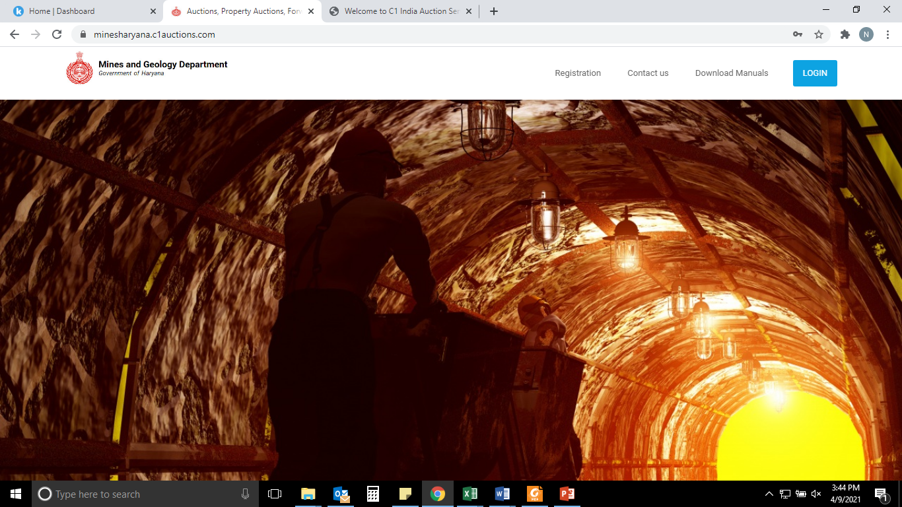
Payments Manual – Haryana Mines Auction Portal

Slide 2
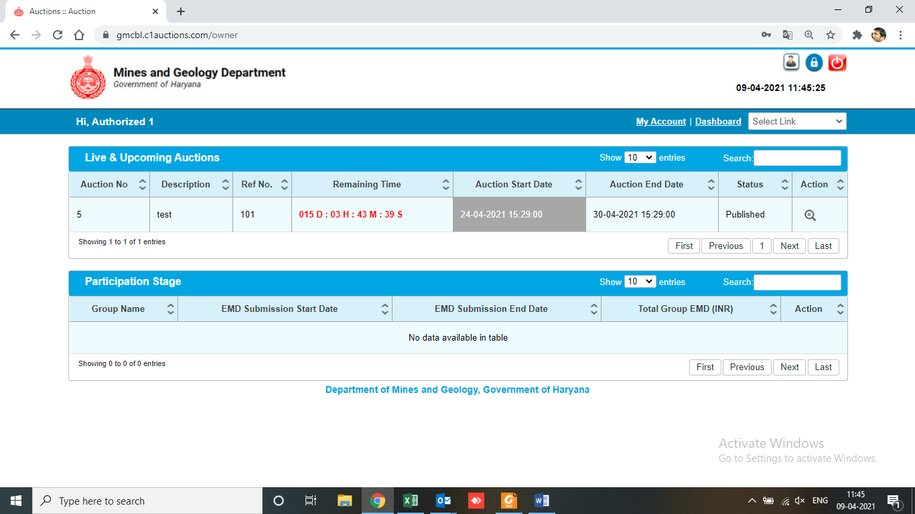
Add EMD Funds
After being declared H1 during an auction, you will be expected to top up your EMD with the amount equivalent of blocked EMD amount.
Click Here to top up your EMD

Slide 3
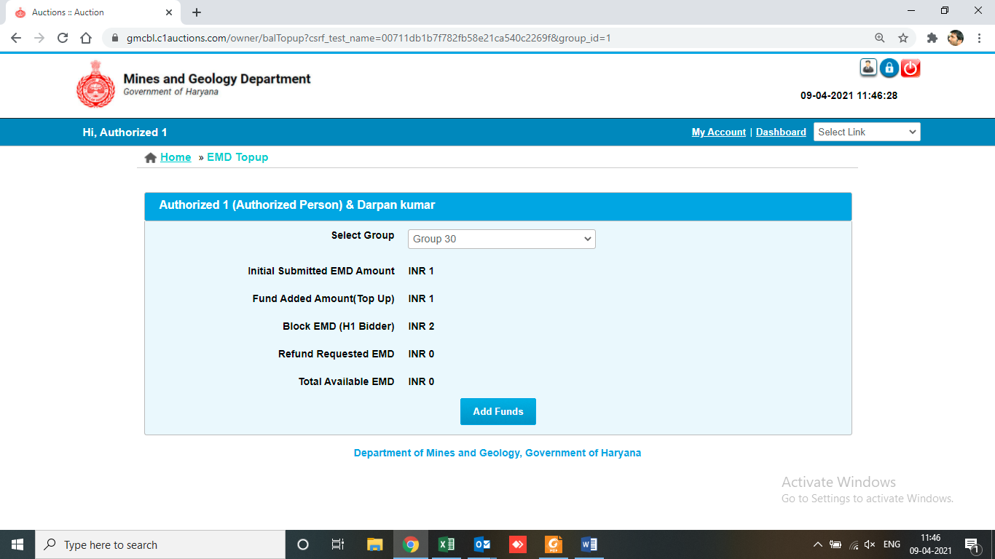
1-Select Group Here
2-Click Here

Slide 4
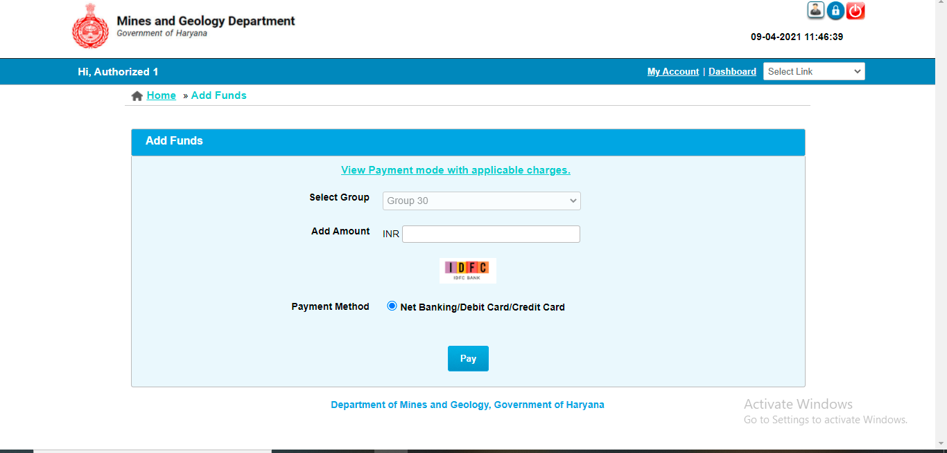
Amount to be added is to be filled and mode of payment is to be selected:

Slide 5
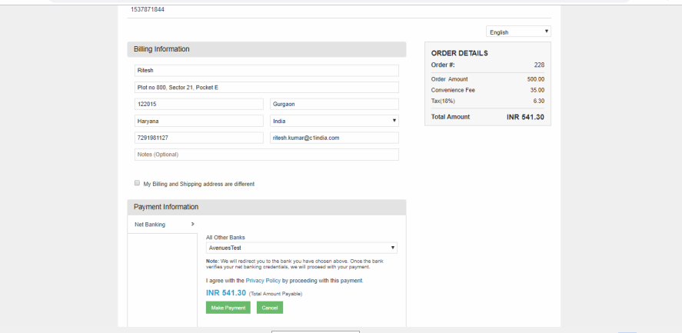
Payment details will have to be entered and authenticated by the participant / bidder. After successful payments (EMD / Auction Fee), bidder can participate in the auctions

